Slide 1
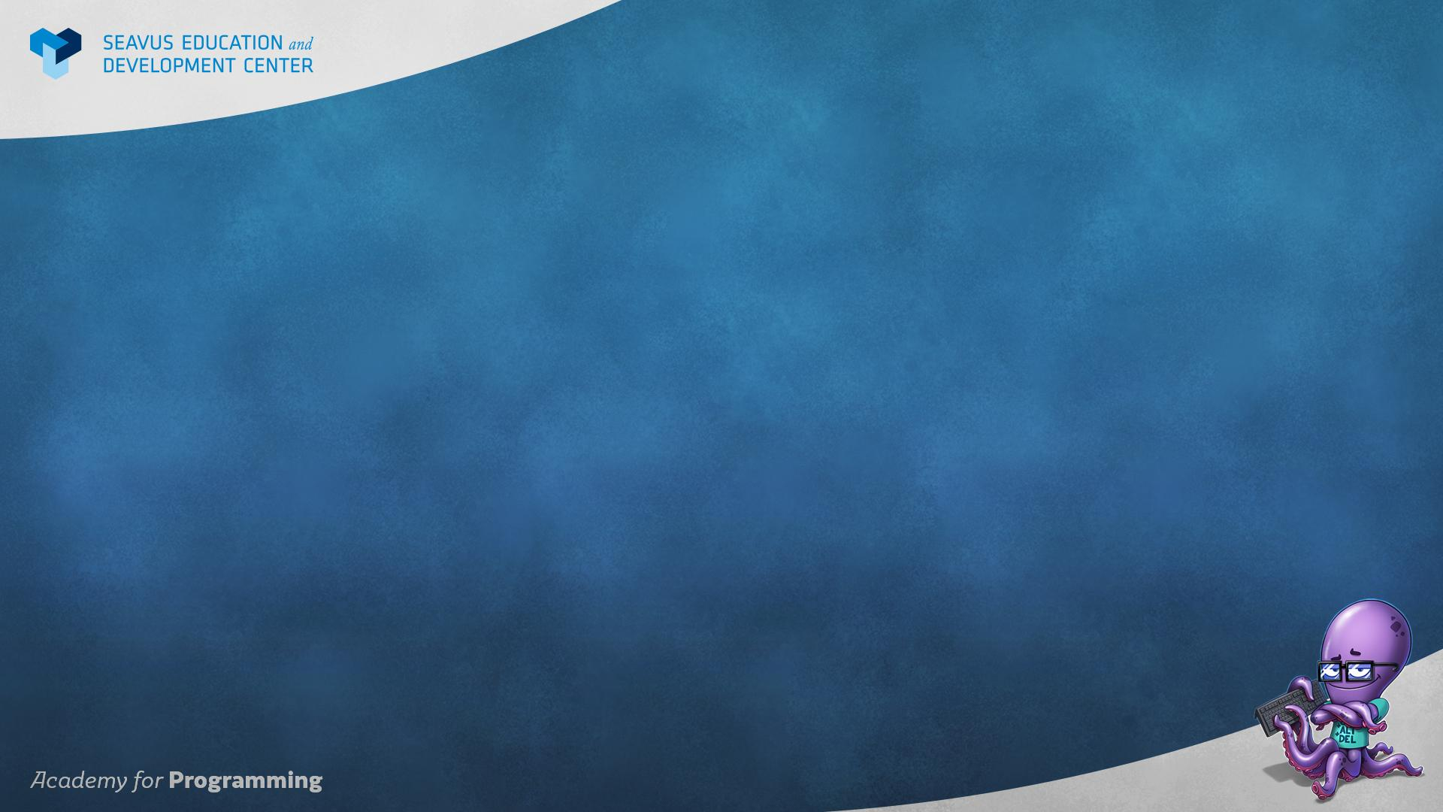
Practical ASP.NET apps development
Trainer – Filip Kerazovski
Assistant – Kristijan Karanfilovski

Slide 2
ASP.NET FRAMEWORK
A framework for building web applications and services in the .NET and .NET Core framework
The framework contains tools, features and libraries that help with development of web solutions
It gives us multiple options and presets to start building web applications
There are a lot of platforms and frameworks for other languages that serve a similar purpose

Slide 3
VISUAL STUDIO PROJECT TEMPLATES
Visual Studio has built in project templates for ASP.NET projects
These templates come with all the necessary libraries installed as well as a base folder and file structure
There are multiple templates for different ASP.NET projects
We are going to use the ASP.NET Core Web Application - Web Application (Model-View-Controller )

Slide 4
MVC DESIGN PATTERN
MVC is a design pattern used to organize and structure applications
MVC stands for Model View Controller
Model - Entity with business logic data
View - The interface that the user interacts with
Controller - The system that manages requests between the view and the back-end through models

Slide 5
BENEFITS OF THE MVC PATTERN
Organizing the code making it easy to get around
Structure the code so that we don't duplicate code
Separate concerns so that we can easily change things without affecting the whole application
Separate the user and the data so that users do not have direct contact with our data
Scale and develop our application faster and safer

Slide 6
MODEL
Dynamic applications work by changing the data in the view constantly
The packages in which the data is stored in are called models
Models are basically objects of classes that contain some business logic
We send models from the controllers to the views

Slide 7
SENDING DATA TO A VIEW
Models are used to contain data for sending to a particular part of our application
We can send a model to our view and use the data from that model inside the view ( HTML )
We can only send ONE model to a view ( Or ONE list of models )
We can also use ViewBag and ViewData to send data to a view

Slide 8
DIFFERENT TYPES OF MODELS
Depending on the architecture of the application there can be different types of models
Every type of model is specialized for transferring data from one part of the application to another
Examples of this are:
Domain models - Models that represent the core business logic entities
View models - Models that represent only the data needed for one particular view

Slide 9
VIEW (RAZOR ENGINE)
An engine that allows us to write and use C# within our HTML view
The engine has a special syntax that allows to switch between C# and HTML easily
The C# code is executed on the server BEFORE the HTML is sent to the client
When all the C# code is executed and resolved, the HTML view without C# code is sent to the client

Slide 10
HOW TO USE RAZOR SYNTAX
@code - for executing C# values and methods
@(code) - for adding expressions result directly to html
@{code} - for executing multiple lines of c# code ( block )
@using - for referencing some import

Slide 11
DIFFERENT TYPES OF VIEWS
In ASP.NET MVC projects there are different types of views that we can use
Layout - A shared layout view wrapping any other view
Partial - A view that consists of an independent small component that can be used multiple times in other views
ViewStart - View with shared code for all views
ViewImports - View with shared using references for all views

Slide 12
CONTROLLER
A controllers manage the requests from and to the back-end
Every request that we do to our application must go through the controller
The controller in ASP.NET is a class containing methods which are called actions
Actions are the in and out points in the controller
Requests on different addresses ping different
actions in the controller

Slide 13
ACTION RESULTS
Actions can return different types of results
ViewResult - Returns an HTML view back to the client
RedirectResult - Redirects to another action
EmptyResult - Returns nothing deliberately
JsonResult - Returns a json file
Actions return type is usually IActionResult which covers all action result types

Slide 14
ROUTING IN MVC APPLICATIONS
A router is a system that manages addresses in our application
When we ask for an address or send some data to an address the router decides which controller and action will get called
The default router in MVC applications looks like this:
websiteName/ControllerName/ActionName
localhost:7888/Home/Index

Slide 15
CUSTOM ROUTES
We can use attributes on our actions and controllers to modify the way they operate
The [Route] attribute can manually override the route to that particular controller or action
We can also use route parameters
Parameters can be added in the route and action and have a variable parameter in the address such as an id

Slide 16
SOFTWARE ARCHITECTURE
Using one project for everything that we need for an application can not only be hard to work with, but it can be a security risk as well
A specific organization and structure of an application is called Architecture
Three are a lot of architectures that are used in the industry for building web applications
One of the base and standard architecture is the N-Tier architecture

Slide 17
N-TIER ARCHITECTURE
N-Tier architecture or Multi-Layer architecture is an architecture where we organize our code in layers
N stands for how many layers are used
Each layer represents a logical part of the application
3-Tier architecture example:
Data Access Layer - Layer that communicates with the DB
Business Layer - Layer that holds the business logic and mediates requests from the presentation to the database layer
Presentation Layer - Layer that contains the UI of the application ( Users interact with this layer only )

Slide 18
DESIGN PATTERNS
Design pattern is an idea or solution to a common problem or issue in software applications
Design patterns can be ideas for communication, for sending data a certain way, handling dependencies or even generating code automatically
We can use multiple design patterns if we need solutions for certain problems
Design patterns should not be used by any means just because they are cool. They are solutions to problems

Slide 19
REPOSITORY DESIGN PATTERN
Pattern for better communication with a data source
It organizes and combines all methods for requesting and receiving data in one place based on business logic ( Entity usually )
It usually contains the CRUD methods for a business entity
CRUD - Create, Read, Update, Delete

Slide 20
CONNECTING TO A DATABASE
Data storage is very important for a dynamic web application
We can connect ASP.NET applications to a database
There are multiple ways of doing that:
Using the ASP.NET internal methods ( manually calling MSSQL queries, procedures and views )
Using an object relational mapper to do most of the work automatically

Slide 21
OBJECT RELATIONAL MAPPING
Object Relational Mapping is a process where we bridge the communication between two types of data
For web application, that is usually from the back-end language to the database language ( C# <-> MSSQL )
Frameworks that do this are called object relational mappers and are used to make our communication with the database easier and simpler

Slide 22
ENTITY FRAMEWORK
Entity framework is the most popular ORM for ASP.NET applications
It can create, communicate, modify and keep track of changes to databases
Two commonly approaches with EF are:
Code First - We write the models in C# and the database is created and modified by the changes of the models
DB First - We create the DB and the models are created and modified by the changes in the DB

Slide 23
CONTEXT EXPLAINED
EF represents the database structure in the C# code with a class called Context
The context holds sets of models which represent tables
The objects in the sets represent the table rows
The properties of the objects are columns
Every time we change the structure of the Context from C#, we must update the DB with the changes and vice-versa

Slide 24
MIGRATIONS IN ENTITY FRAMEWORK
Keeping the DB and Code in sync as well as keeping track of the versions in EF is done with migrations
Every time we change a model or the context we must create a new migration and run it on the DB
If we don’t the DB and Code will be out of sync and we would get errors
We can create, remove and run migrations on the DB by typing out commands in the Package Manager Console

Slide 25
ABOUT THE SUBJECT
The focus of the subject will be to build dynamic web applications using the ASP.NET framework
After each class the source code will be uploaded to git repository

Slide 26
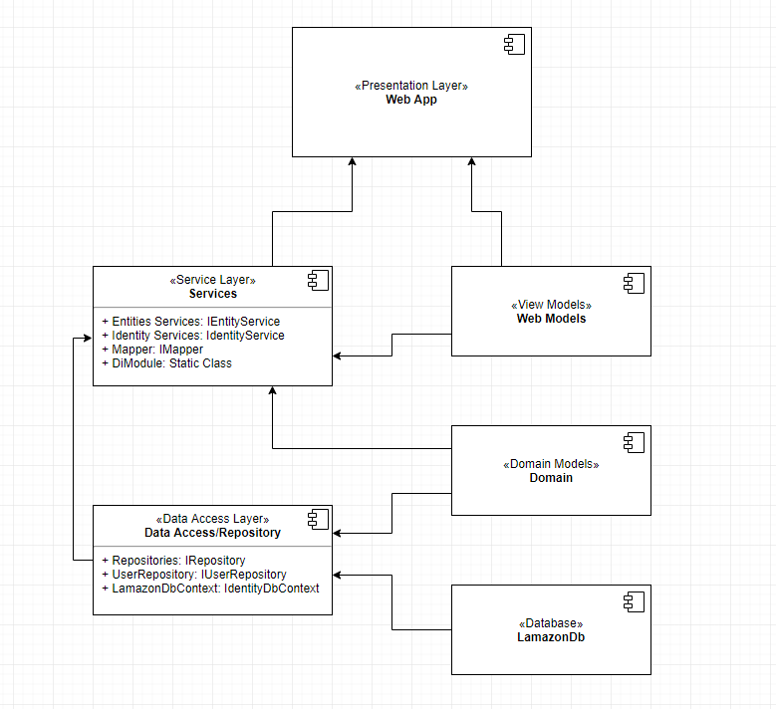
COMPONENTS

Slide 27
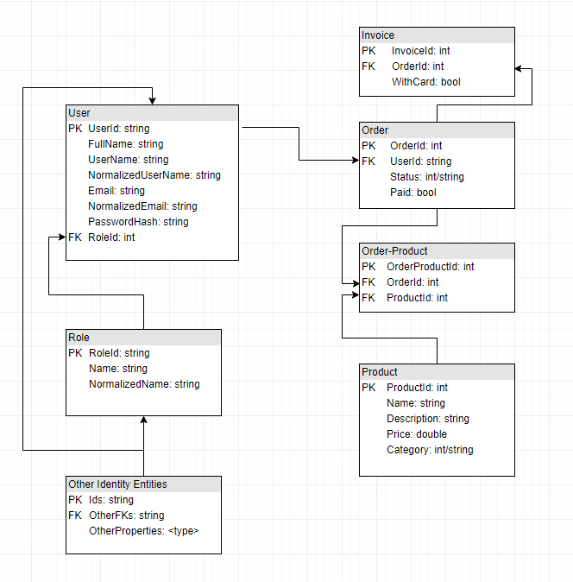
ENTITIES

